Slide 1

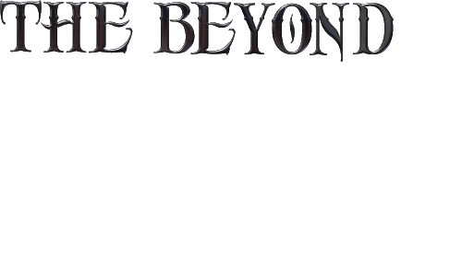
An immersive Adventure, Puzzle Game.

Slide 2
THE BEYOND
IS A DIMENSIONAL EARTH LIKE
WORLD, FILLED WITH MYTHICAL CREATURES.
BOUND TO LOST STORIES AND HISTORY.
DISCOVER WHAT IS ODD ABOUT THIS WORLD.
ADVENTURE THROUGH BEAUTIFUL AND DANGEROUS LANDS.
IMMERSE AND EXPERIENCE
YOUR WAY!
YOUR PATH!
YOUR ADVENTURE!

Slide 3
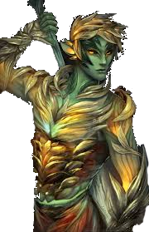
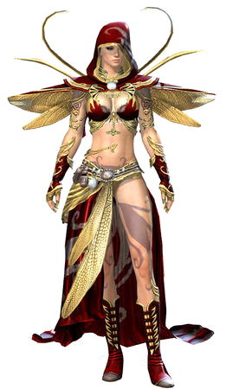
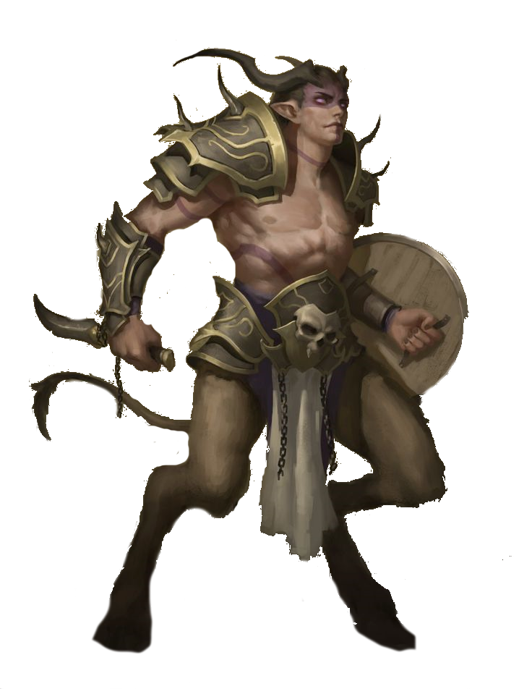
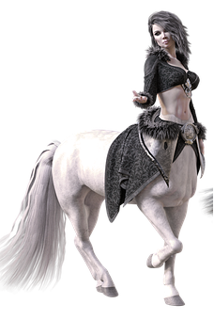
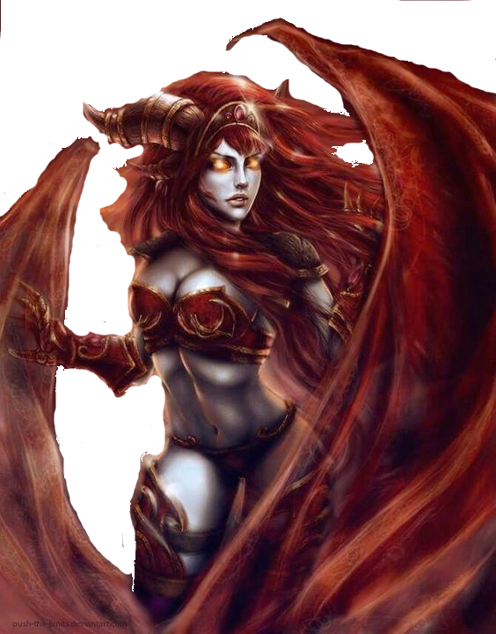
Target Audience
The target Audience is of a mature group aged 18 and up due to the maturity of the content. We are confident in saying that this game will appeal to this audience because of the level of success that similar games with the same target audience such as the Dark Souls series have achieved.
Target Platforms
Steam, PC (digital and physical copies)
VR (pending viability)
Other Platforms TBA (potentially)

Slide 4
Platform For Demo
The Beyond demo version as a open world adventure Vertical Slice puzzle and open world battle game.
For the Demo version the game will be suited for Personal Computers only. The game play is based on foundational elements of current RPG single player games. The player is immersed in a mythical world with connections to current earth history experiencing ‘The Beyond“. the world as the original source of mythical culture’s surrounded by Greek themed environment.
Setting and Aesthetic
High Fantasy
High detailed characters
Music :TBD
UI: Medieval fantasy

Slide 5
Gameplay
Old-school RPG gameplay
Stats such as Strength, Dexterity, Intelligence, Wisdom, Charisma, Constitution, Evade
Battle enemies with the skills you learn
Obtain and sell loot from battle
Complete quests for NPCs

Slide 6
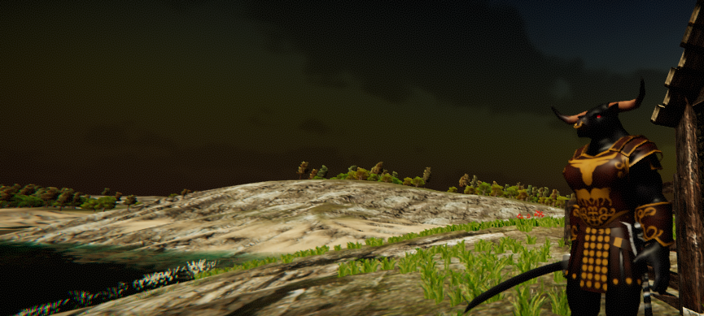
DEMO
GAME PLAY
Single player Game play, at least an hour worth of content including quests
Main Quest (Story)
Fetch Quests
Two Races to choose from at minimum
Minotaur
Succubus
Two basic class types that can be chosen for your character
Blood Fray (Fighter)
Necromancer

Slide 7
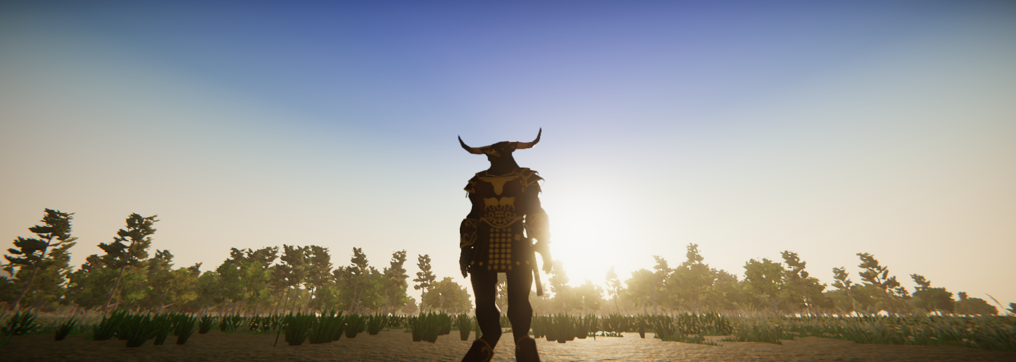
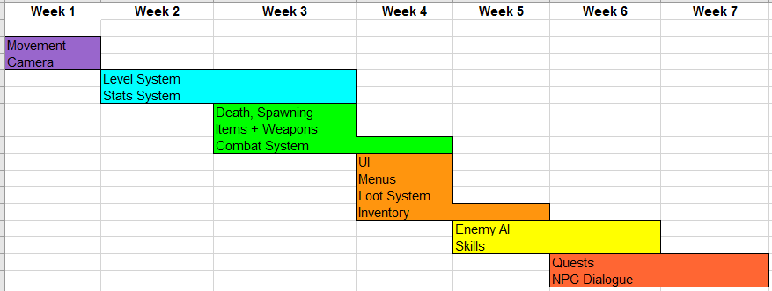
Gameplay Mechanics Timeline

Slide 8
Story Line/ Art Intro
Prologue
A world that was created by the Ancient Guardians of Time. With this they Combined their powers to create a sentient being who in turn created life on earth and the mythological beings. As time went by an unknown Ancient guardian appeared who created humans amongst the creatures to rule the mythological beings, Peace and cohabitation had diminished, Chaos and destruction rained upon the world something had to be done. The ancients returned and discovered that Humans were corrupting and driving the other species to extinction and so they split their world in two, leaving humans to rule one and mythical creatures to rule the other, Banishing the humans to another dimension. But with this the Ancient Guardians unknowingly ripped the fabric of time.
With these cracks there have been open portals appearing on the human earth and ancient history and present day humans have been appearing where the mythical creatures live. Unfortunately humans can only live for a short time in these lands to survive they have to make a choice;
Morph into one of these fantastical creatures or Die.

Slide 9
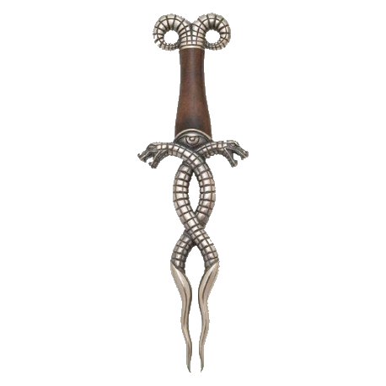
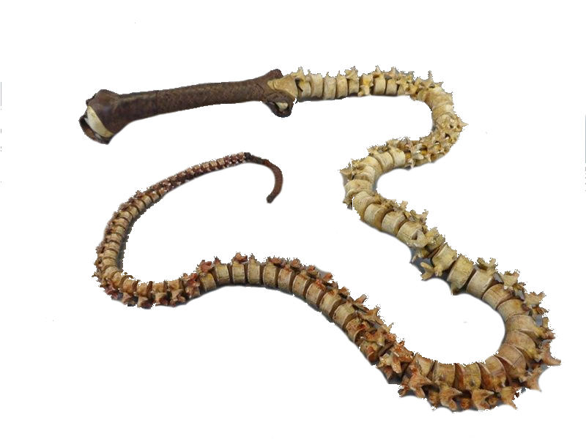
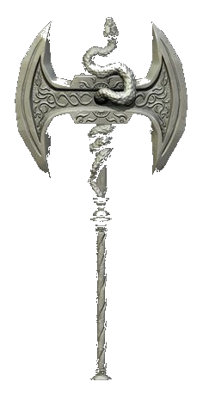
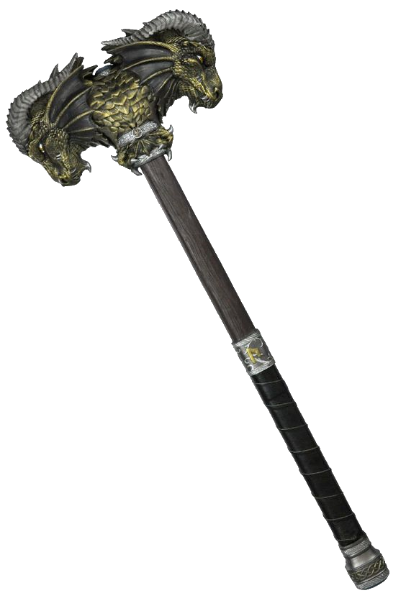
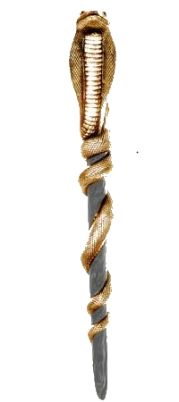
The Vision
The game play to be made on in the ESSENCE of Ever-quest 2, World of Warcraft, Dark age of Camelot, Dark Souls, Ashons of creation and Rift. With the thrill and SOUL of a adventure, puzzle game structure.
Fast paced action, with multiple open world Battles. A wide verity of unique Weapons and Armor to suit your character including hand to hand, ranged weapons, spell casting just to name a few.

Slide 10
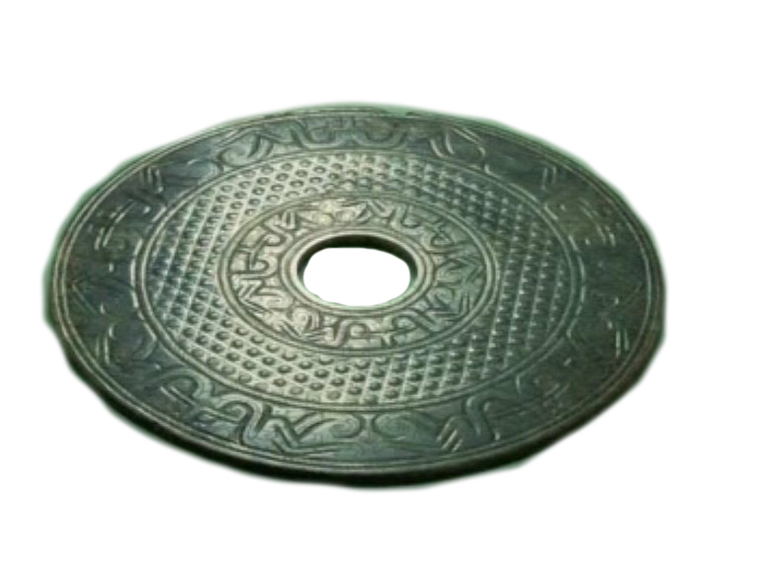
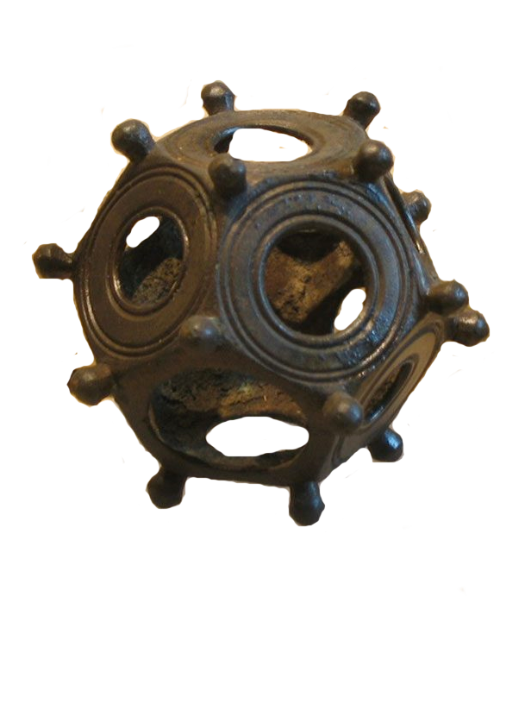
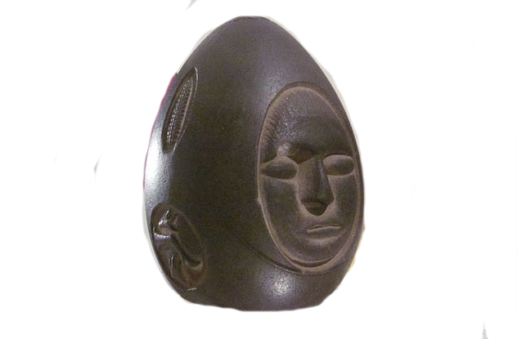
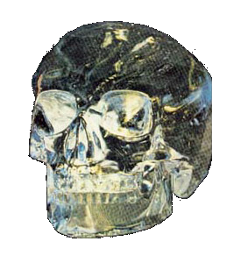
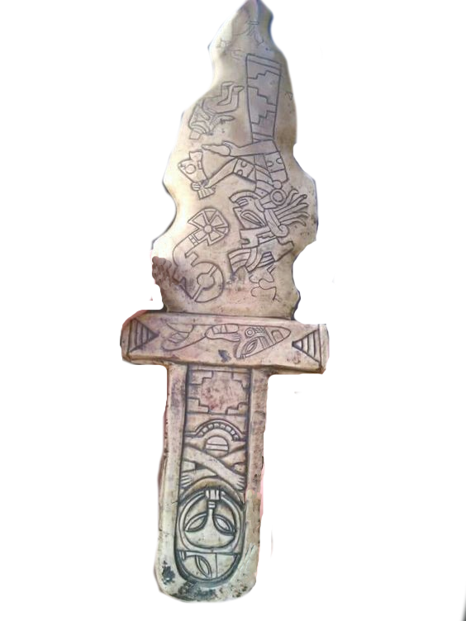
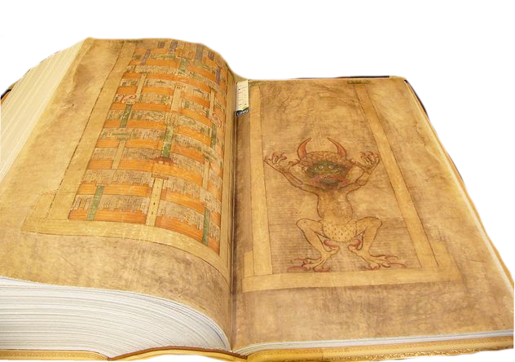
The Vision
Ancient earth objects keep appearing and locals are frightened as they are unaware of what they are, you as a adventurer must take up the challenge to adventure out into the unknown and find them and put things right.

Slide 11
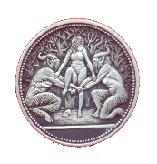
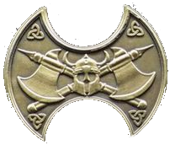
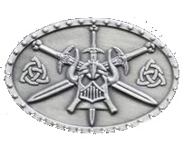
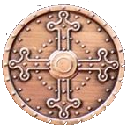
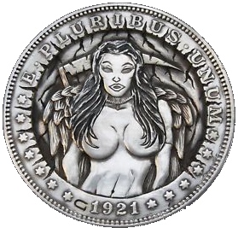
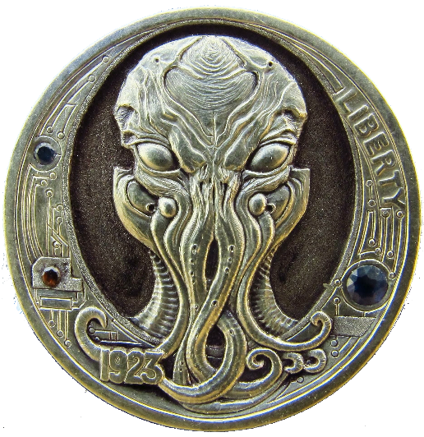
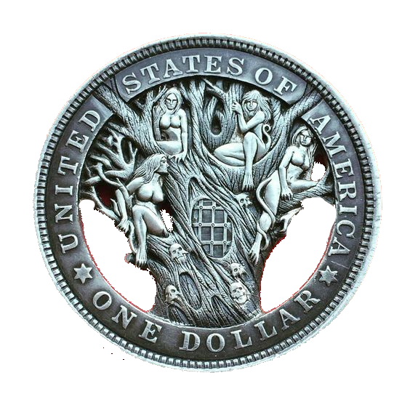
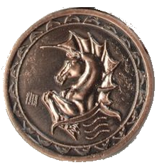
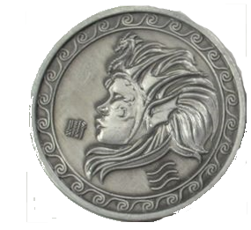
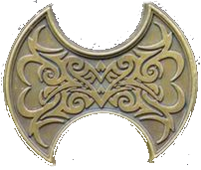
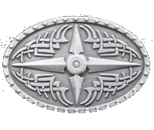
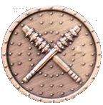
Vision Statement
In this world every action has a reaction that effects as you progress with your character.
The player fights enemies, perform a wide variety of missions (quests) which help you discover why you are there and who you are. Collect items, achievement's, levelling up and help with towns/cities. Strategic elements to interact with solving puzzles and Environment vs Player missions and battles.
Items can be sold or used to gain new equipment for your character.
Currency and Barter system used to trade with NPCs to receive armor, equipment, and weapons as needed to improve your character.

Slide 12
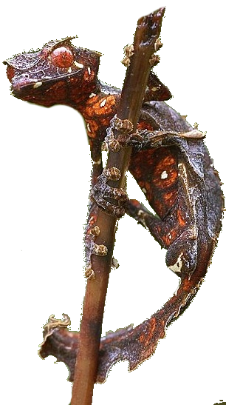
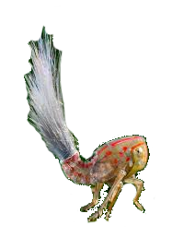
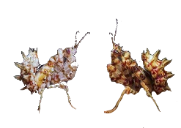
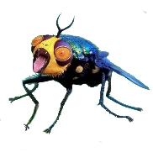
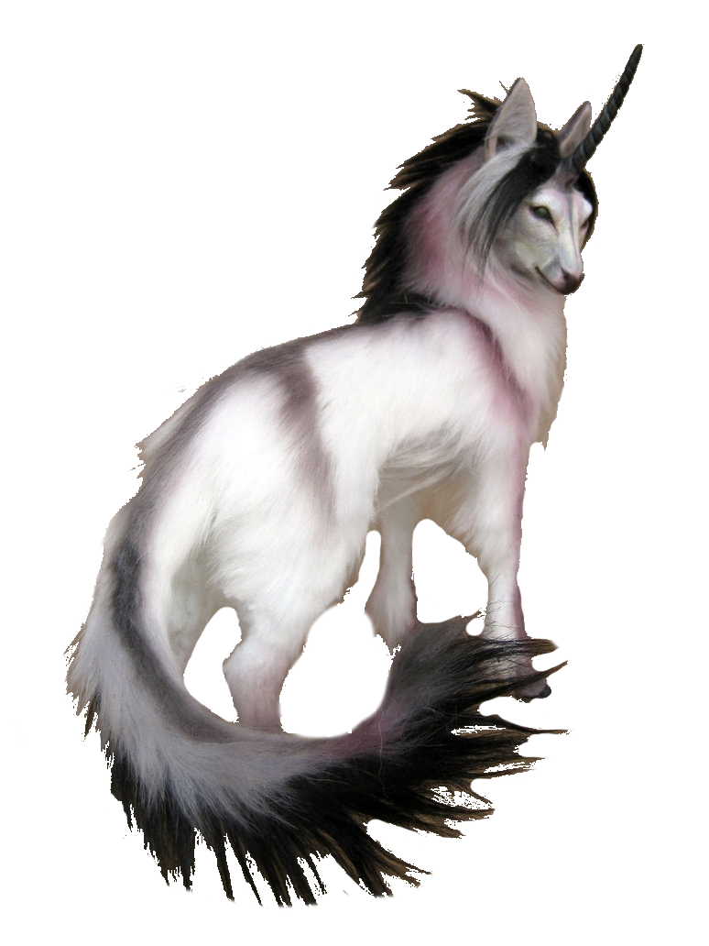
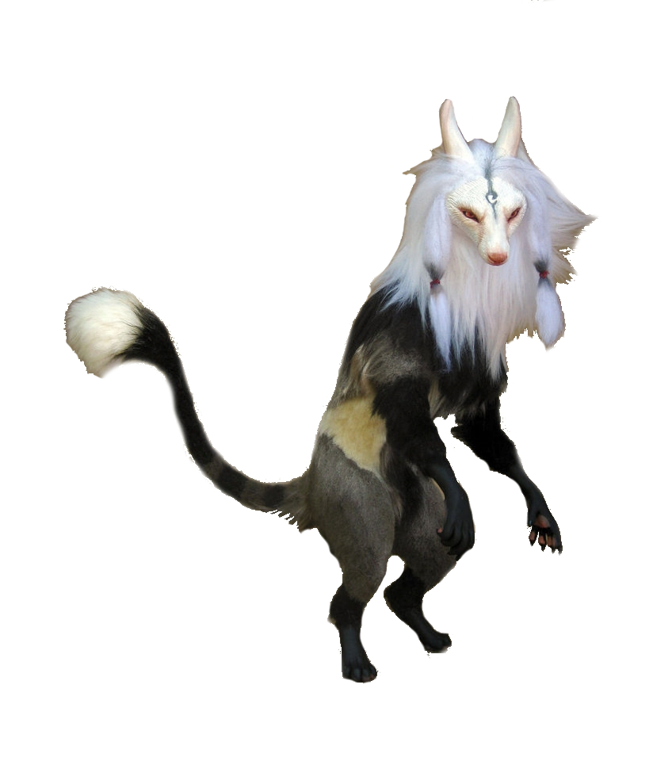
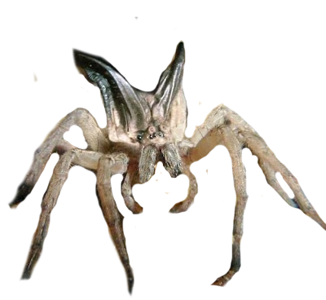
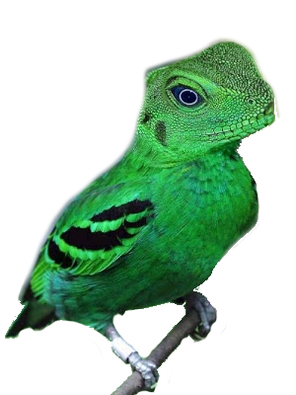
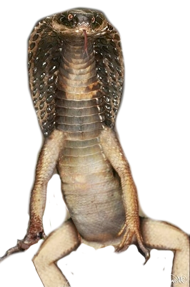
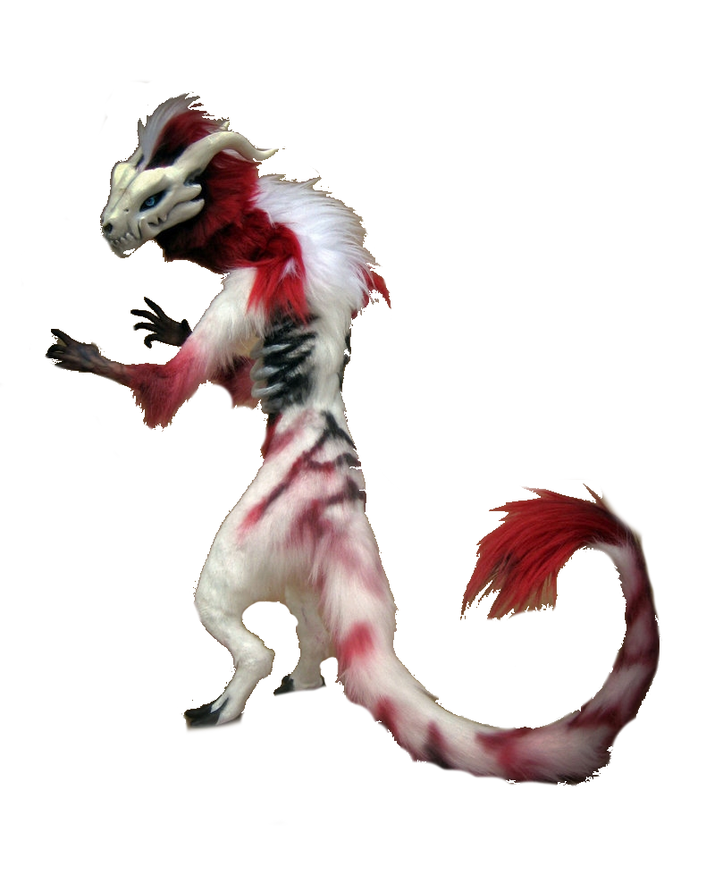
Few of the creatures that you Might bump into along the way

Slide 13
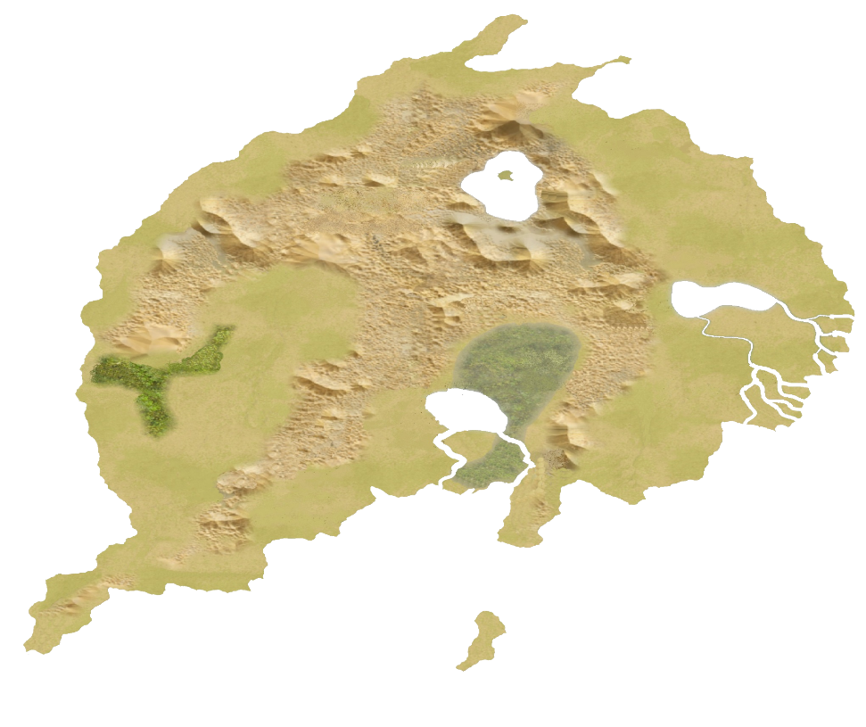
THE CONTINENT SARLONA

Slide 14
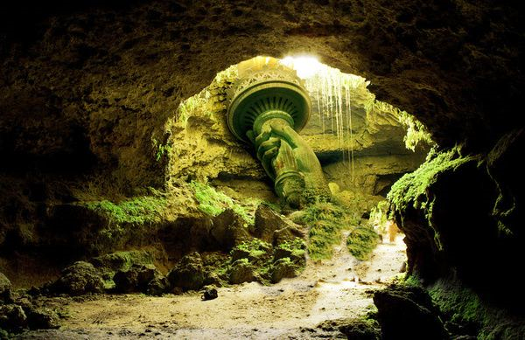
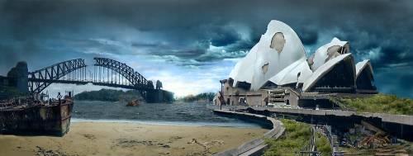
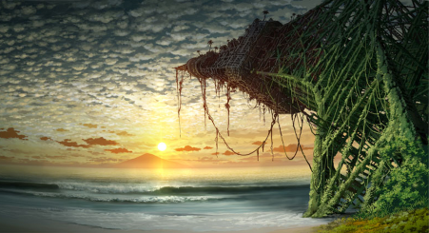
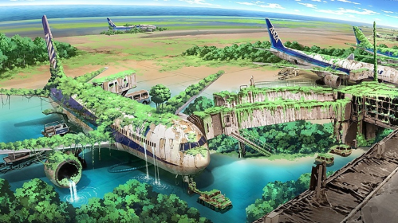
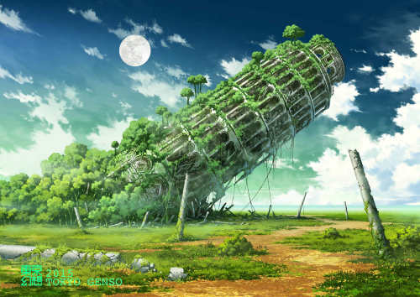
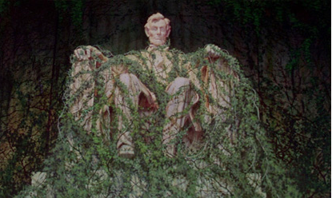
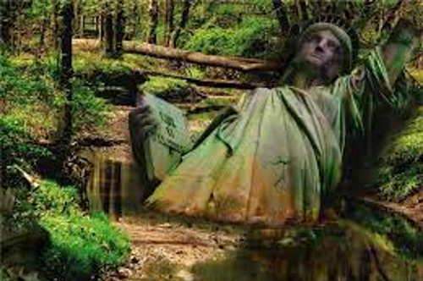
Few Sights that you might come across in your Adventures

Slide 15




Caving system

Slide 16


The town that you arrive in

Slide 17








Photo Scanned Environment

Slide 18


Art Timeline

Slide 19
Hopeful Outcome of Project and Milestone/Goal Setting
Now in reality, these art and playability concepts are seemingly quite big for this project. We say seemingly because we have already near completion and or completed some of our goals and milestones!

Slide 20

Minotaur Texture ready need to Rig

Slide 21


Succubus ready to be textured and Rigged

